Slide 1
Need for management
Dr. Koninika Mukherjee

Slide 2
Definition
Louis Allen defined profession as "a specialized kind of work practiced through and by use of classified knowledge, a common vocabulary, and requiring standards of practice and code of ethics established by a recognized body."

Slide 3
What is management
Economics | Sociology | Process | Discipline
The economist's view of management is that it is a factor of production just like entrepreneurship, capital and labour. The managerial resource, to a large extent, determines organisational effectiveness and efficiency. | Sociologists view management as a class and status system. Increasing complexity of management in the modern complex organisation has led to managers to be regarded as a distinct class in society, who possess knowledge and skill of a high order. | Interpreted as a process, management consists of a series of inter-related managerial activities classified into various functions like planning, organising, staffing, leading and controlling. Managers undertake these functions with a systematic approach, so as to integrate physical and human resources into an effective operating unit. Management is, thus, regarded as the process by which a co-operative group directs action towards common goals. | Another connotation of management is that it is a separate discipline having a systematised body of knowledge which managers use in performing heir jobs.

Slide 4
What is management
Human Relations | Decision | Systems | Contingency
This conceives it as a social system because managerial actions are principally concerned with relations between people and the development of people. The essence of this school is well reflected in the definition of Lawrence Appley to whom management is the accomplishment of results through the efforts of other people. | The Decision School defines management as rule-making and rule-enforcing body. Decision making power provides a dynamic force for managers to transform the resources of organizations into a productive and cooperative concern. | Organizations are organic and open systems consisting of interacting and interdependent parts and having a variety of goals. Managers are supposed to maintain balance among the conflicting objectives, goals and activities of members of the organization. | There is no best way to design organizations and manage them. Managers should design organizations, define goals and formulate policies and strategies in accordance with the prevailing environmental conditions.

Slide 5
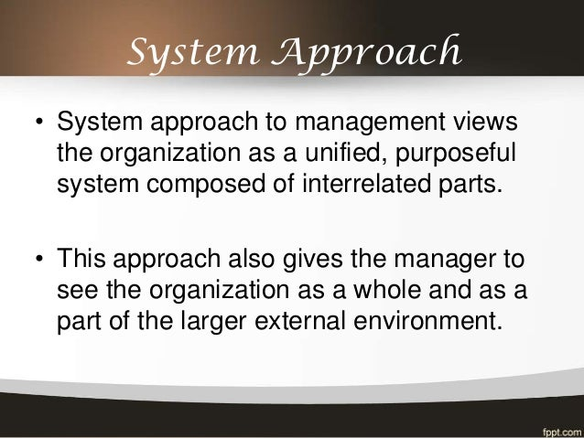

Slide 6
System
A system has the following components:
a number of parts or sub-systems, which when put together in a specific manner form a whole system;
boundaries within which it exists;
a specific goal(s) expressed in terms of an output, which is achieved by receiving an input and processing it to form the output;
close inter-relationship and inter-dependency amongst various subsystems.

Slide 7
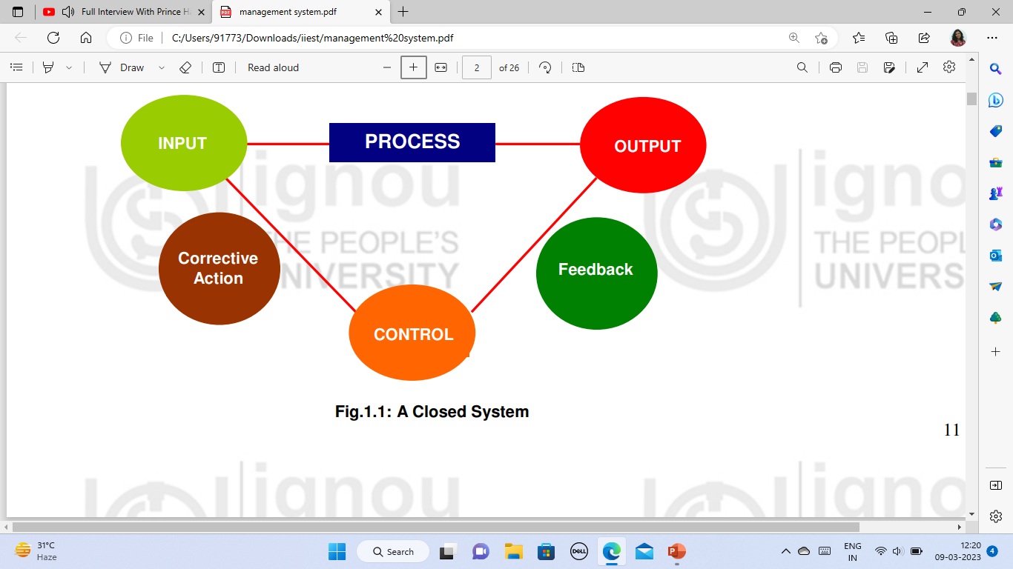
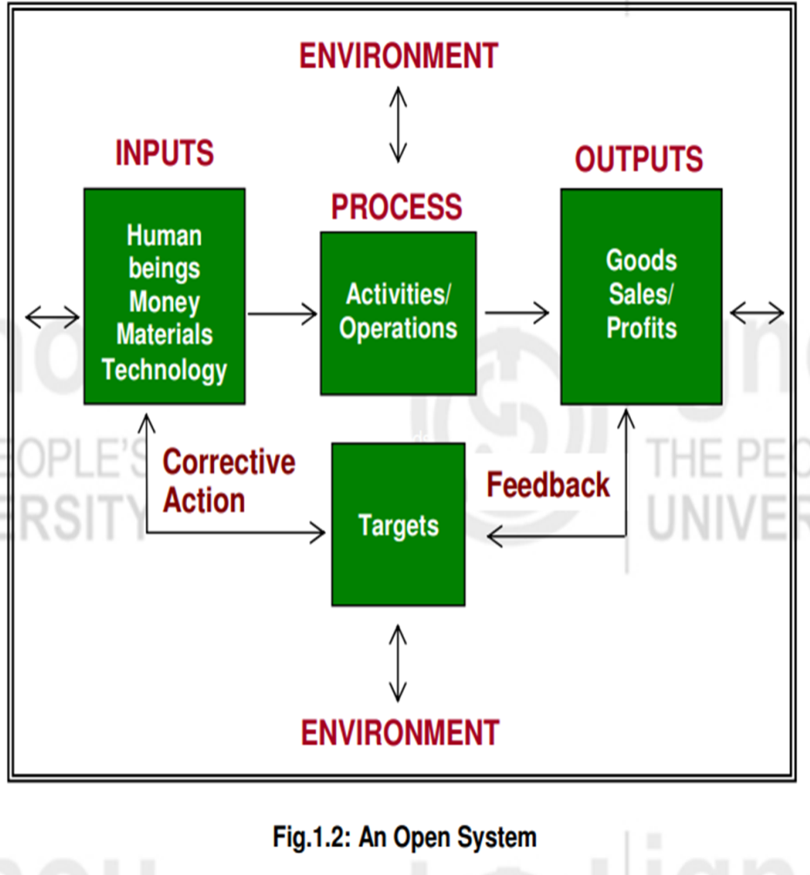
Types of Systems

Slide 8
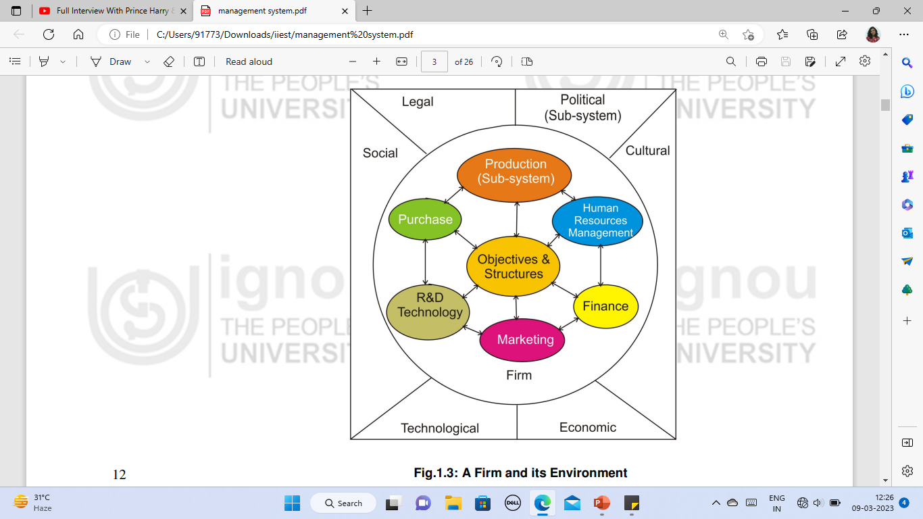

Slide 9
Inter-relationship of sub-systems
The inter-relationship of sub-systems can be defined in terms of the:
a) flows such as of information, funds, materials, etc. The most important of these is the information flow;
b) structure within which they relate to each other. The structure may be physical, geographic or organizational;
c) procedures by which the sub-systems relate to each other. By procedures we mean those planned activities, which influence the performance of the entire system. In the context of an organization, this refers to planning.
d) feedback and the control process mechanisms which ensure that the system is moving towards its desired objectives.

Slide 10
Difference between administration and management (American school of thought)
Administration
MANAGEMENT
Broader concept
Sets objectives
Lays down policies
thinking function or a top level function
Relatively narrower concept
leads, directs and guides the organisation in the accomplishment of predetermined objectives.
management operates under said policies
management is a doing function or lower level function engaged in execution of the plans

Slide 11
Types of Management
Administrative management is top management in-charge of planning function.
Operative management is middle and lower level managements responsible for execution of the plans.

Slide 12
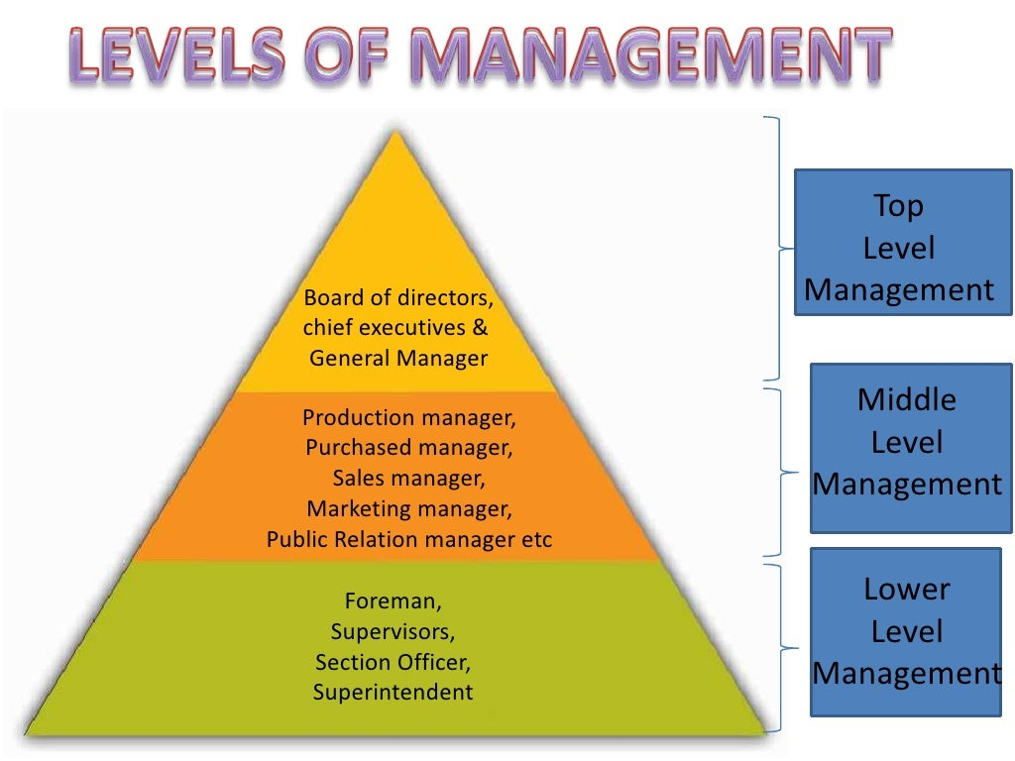

Slide 13
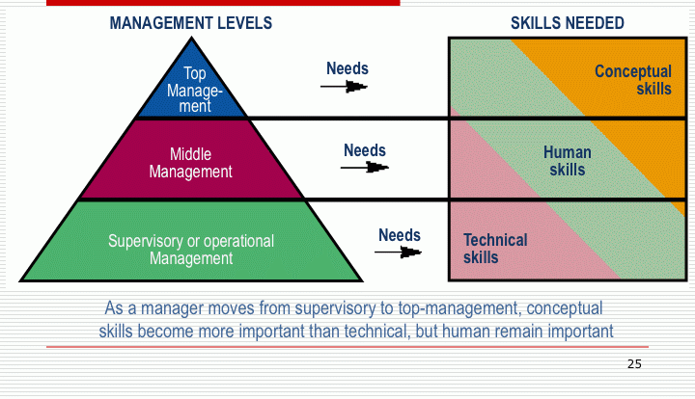
Managerial Skills

Slide 14
Management Process
Planning - Planning refers to anticipating the future conditions and choosing from among the alternative future courses of action.
Organizing - The organising function of management is the process of defining and grouping of activities and creating authority relationship among them. It consists of:
Developing the organisation structure which involves identification of task and grouping them into units or departments for performance.
Delegating authority to the managers and making him responsible for group performance.
Establishing relations creating conditions necessary for mutually cooperative efforts of people in the organisation.

Slide 15
Management Process
Staffing : It involves selection, training and development, compensation, and appraisal of subordinates by the manager.
Directing : Directing involves managing people and the work through the means of motivation, proper leadership, effective communication and coordination. A manager must be able to secure willing obedience from his subordinates without destroying their initiative and creativity. Moreover, it requires a sound communication system to enable exchange of ideas and information for common understanding.
Controlling : It enables management to ensure that achievement is in accordance with the established plans. It involves
Establishing performance standards for evaluating results
Performance on the basis of records and reports on the progress of work.
Performance evaluation against the standards set.
Corrective action to regulate operations, remove deficiencies and improve performance.

Slide 16
Nature of Management

Slide 17
Systematic knowledge : Every profession has a well defined area of organized knowledge. Techniques of management developed by drawing knowledge from other branches like economics, mathematics and so on, facilitate managers to perform their, job better. Coordinated decision making in organization is made possible by application of the same theory by all managers in their decision making. Managers should possess experimental attitude in acquisition of new knowledge so as to prove successful in an ever-changing organizational environment.
Performance-based status : Manager's status in the present day organization is linked to its performance rather than other extraneous factors like family or political connections.

Slide 18
Code of ethics : Professionals must be governed by a strict code of ethics formulated and enforced by professional bodies to protect their members integrity. Since it is difficult to identify clearly the membership of management associations and their role, managerial codes of ethics has not yet evolved so as to be acceptable to all practicing managers.
Dedication and commitment : True professionals through dedication and commitment serve their clients interest. Managers today are expected to serve the long-run interest of the organization but they are also conscious of their social responsibilities. Besides, they are entrusted with wealth producing resources of society which they are expected to put to the most effective use.

Slide 19
Managerial Responsibilities

Slide 20
Responsibility towards owners : The primary responsibility of management is to assure a fair and reasonable rate of return on capital and fair dividend to the shareholders as investors and risk bearers. What is a fair return on investment can be determined on the basis of difference in the risks of business in different fields of activity. With the growth of business the shareholders can also expect appreciation in the value of their capital.
Responsibility towards employees : Management responsibility towards employees relate to the fair wages and salaries, satisfactory work environment, labour management relations, and employee welfare. Fair wages should be fixed in the light of labour productivity, the prevailing wage rates in the same or neighbouring areas and relative importance of jobs. Managers salaries and allowances are expected to be linkcd with their responsibility, initiative and skill. But the spread between minimum wages and highest salaries should be reasonable. Managers are expected tb build up and maintain harmonious relations between superior and subordinates. Management and union relations should be harmonious and cooperative. Another aspect of management responsibility towards employees is the provision of welfare amenities like safety and security of working conditions, medical facilities, housing, canteen, leave and retirement benefits.

Slide 21
Responsibility towards consumers : In a competitive market, serving consumers is supposed to be a prime concern of management. Management should satisfy consumer needs and protect consumer interests. Goods must be of appropriate standard and quality and be available in adequate, quantities at reasonable prices.
Responsibility towards the governments : As a part of their social responsibility, management must conduct business affair in lawful manner, honestly pay all the taxes and dues, and should not corrupt public officials for selfish ends. Business activities must also confirm to the economic and social policies of the government.
Social responsibility: The socially responsible role of management in relation to the community are expected to be revealed by its policies with respect to the employment of handicapped persons, and weaker sections of the community, environmental protection, pollution control, setting up industries in backward areas, and providing relief to the victims of natural calamities.

